Slide 1

Autoregressive Time Series
Dr. Abolfazl Saghafi
Assistant Professor of Statistics & Data Science
Notes:
We continue this week with introducing Autoregressive time series and investigate their properties. We also define Partial Autocorrelation function that help us identify Autoregressive time series

Slide 2
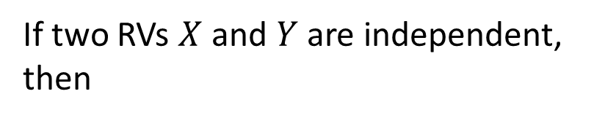
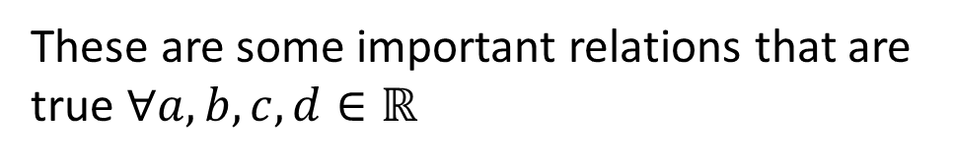

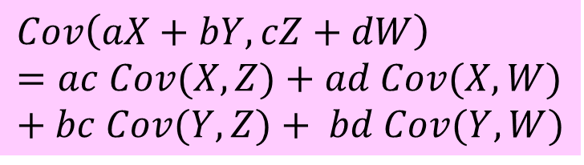


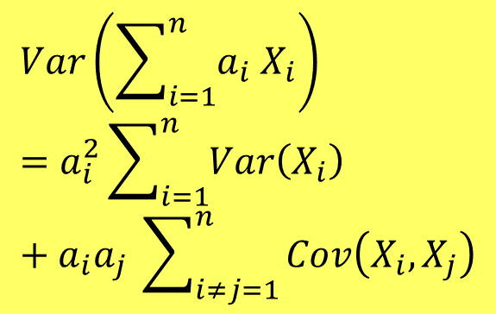



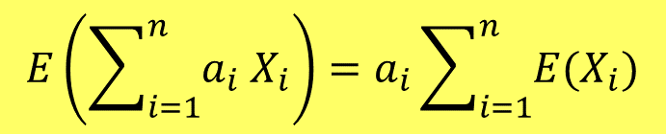
Reminder
If two RVs $X$ and $Y$ are independent, then
$$E\left(XY\right)=E\left(X\right)E\left(Y\right)$$
These are some important relations that are true $∀a,b,c,d∈ℝ$
$$Cov\left(X,Y\right)=0=Corr\left(X,Y\right)$$
$$E\left(aX+b\right)=aE\left(X\right)+b$$
$$E\left(\sum_{i=1}^{n}{a_{i} X_{i}}\right)=a_{i}\sum_{i=1}^{n}{{E(X}_{i})}$$
$$E\left(aX+bY\right)=a E\left(X\right)+b E\left(Y\right)$$
$$Var\left(aX+b\right)=a^{2}Var\left(X\right)$$
$$Var\left(aX+bY\right)=a^{2}Var\left(X\right)+b^{2}Var\left(Y\right)+ab Cov\left(X,Y\right)$$
$$Var\left(\sum_{i=1}^{n}{a_{i} X_{i}}\right)=a_{i}^{2}\sum_{i=1}^{n}{Var\left(X_{i}\right)}+a_{i}a_{j} \sum_{i≠j=1}^{n}{Cov\left(X_{i},X_{j}\right)}$$
$$Cov\left(aX+b,cY+d\right)=ac Cov\left(X,Y\right)$$
$$Cov\left(X,Y\right)=Cov\left(Y,X\right)$$
$$Cov\left(X,X\right)=Var\left(X\right)$$
$$Cov\left(aX+bY,cZ+dW\right)=ac Cov(X,Z)+ad Cov(X,W)+bc Cov(Y,Z)+ bd Cov(Y,W)$$
Notes:
A reminder from last week, we will be using the highlighted relation in our computations

Slide 3


Random Walk
● $X_{1}=ε_{1}$
● $X_{2}=ε_{1}+ε_{2}$
● $X_{3}=ε_{1}+ε_{2}+ε_{3}$
$$⋮$$
● $X_{t}=ε_{1}+ε_{2}+…+ε_{t}$
The following time series is known as Random Walk. Compute the ACF and discuss stationarity.
$$X_{t}=X_{t−1}+ε_{t}$$
$$X_{0}=0$$
$$ε_{t} \sim ^{i.i.d} N\left(0, σ\right)$$
Variance increase linearly in time
$$μ_{t}=E\left(X_{t}\right)$$
$$=E\left(ε_{1}+…+ε_{t}\right)$$
$$=E\left(ε_{1}\right)+…+E\left(ε_{t}\right)=0$$
$$γ_{0}=Var\left(X_{t}\right)$$
$$=Var\left(ε_{1}+…+ε_{t}\right)$$
$$=Var\left(ε_{1}\right)+…+Var\left(ε_{t}\right)$$
$$=t σ^{2}$$
$$γ_{1}=Cov\left(X_{t},X_{t−1}\right)$$
$$=Cov\left(ε_{1}+…+ε_{t−1}+ε_{t},ε_{1}+…+ε_{t−1}\right)$$
$$ρ_{k}$$
$$t=100$$
$$=Var\left(ε_{1}+ε_{2}+…+ε_{t−1}\right)$$
$$=\left(t−1\right) σ^{2}$$
1
$$γ_{k}=Cov\left(X_{t},X_{t−k}\right)$$
$$=Var\left(ε_{1}+…+ε_{t−k}\right)$$
$$=(t−k){ σ}^{2}$$
$$=\frac{(t−k){ σ}^{2} }{t σ^{2}}$$
$$=1−\frac{k}{t}$$
0
1
2
3
4
5
6
$$k$$
$$ρ_{k}=\frac{γ_{k}}{γ_{0}}$$
$$k=0,1,2,…$$
-1
Notes:
Random walk is an important and well-know time series that is used in finance. In here we introduce what its simple form is and investigate its properties. We have a random walk when the current value is summation of the past value plus a random noise. For this recursive formula to work, we need to assign a value for $X_{0}$, the starting point, that is usually set as zero, but a random selection is also a good starting point. Using this recursive formula, we can see that …
Starting with mean of this time series.
The form of $ρ_{k}$ suggests a slowly decreasing pattern with increasing lags, the longer the time series is, the slower the decrease will be.
It is evident from these results that random walk is non-stationary time series, variance depends on time, ACF depends on time, plus autocorrelogram decreases slowly and even for high lags, $ρ_{k}$ is not zero.

Slide 4
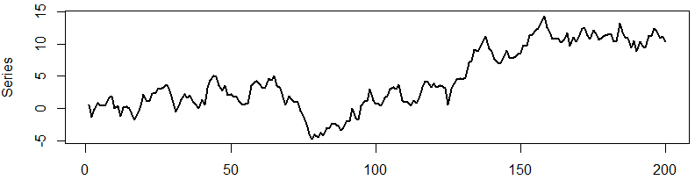
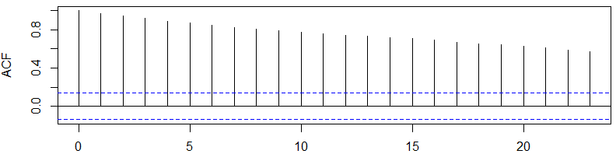
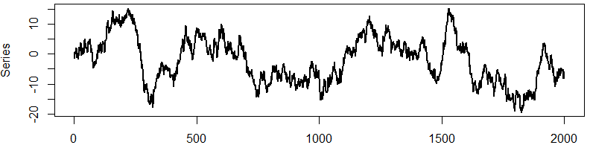
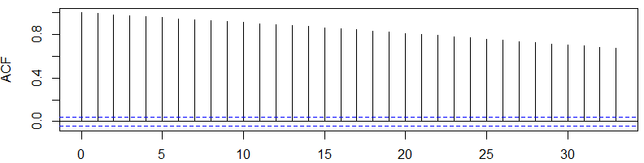


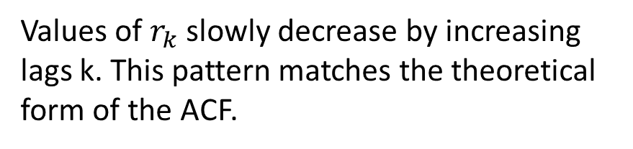
Example
A random walk time series with its auto-correlogram for 200 and 2000 steps using
$$X_{t}=X_{t−1}+ε_{t}$$
$$ε_{t} \sim ^{i.i.d} N\left(0, 1\right)$$
Values of $r_{k}$ slowly decrease by increasing lags k. This pattern matches the theoretical form of the ACF.
Based on what we discussed earlier, this very slow decrease is an indicator of a non-stationary time series.
Notes:
Here we see example of a simulated random walk, the noise has a standard normal distribution. This first time plot is for 200 instances, there seems to be an increasing pattern in the time plot. Values of $r_{k}$ slowly decrease by increasing lags k. This pattern matches the theoretical form of the ACF.
Based on what we discussed earlier, this very slow decrease is an indicator of a non-stationary time series.
The second time plot is the same time series plotted for 2000 instances. There are some short term patterns in the time plot. The ACF shows that values of $r_{k}$ are not even close to zero at lag 33

Slide 5





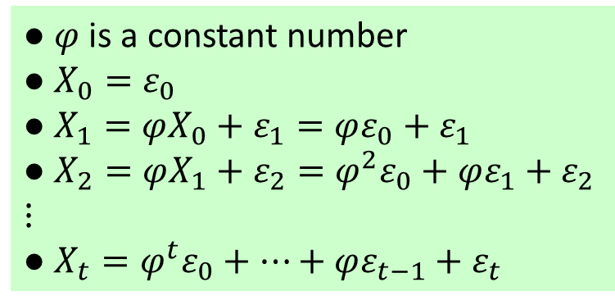











Autoregressive of Order 1
● $φ$ is a constant number
● $X_{0}=ε_{0}$
● $X_{1}=φX_{0}+ε_{1}=φε_{0}+ε_{1}$
● $X_{2}=φX_{1}+ε_{2}=φ^{2}ε_{0}+φε_{1}+ε_{2}$
$$⋮$$
● $X_{t}=φ^{t}ε_{0}+…+φε_{t−1}+ε_{t}$
The following time series is an AR(1). Compute the ACF and discuss stationarity.
$$X_{t}=φ X_{t−1}+ε_{t}$$
$$X_{0}=ε_{0}$$
$$ε_{t} \sim ^{i.i.d} N\left(0, σ\right)$$
$$μ_{t}=E\left(X_{t}\right)$$
$$=E\left(φ^{t}ε_{0}+…+φε_{t−1}+ε_{t}\right)$$
$$=φ^{t}E\left(ε_{0}\right)+…+E\left(ε_{t}\right)=0$$
$$γ_{0}=Var\left(X_{t}\right)$$
$$=Var\left(φ X_{t−1}+ ε_{t}\right)$$
$$=φ^{2}Var\left(X_{t−1}\right)+Var\left(ε_{t}\right)+2φCov\left(X_{t−1},ε_{t}\right)$$
$$=φ^{2}γ_{0}+σ^{2}$$
$$γ_{0}=σ^{2}/(1−φ^{2})$$
$$⇒\left|φ\right|<1$$
$$γ_{k}=Cov\left(X_{t},X_{t−k}\right)$$
$$=E\left(X_{t}X_{t−k}\right)−E\left(X_{t}\right)E\left(X_{t−k}\right)$$
$$=E\left(\left(φ X_{t−1}+ε_{t}\right) X_{t−k}\right)$$
$$=E\left({φ X}_{t−1}X_{t−k}+ε_{t}X_{t−k}\right)$$
$$=φ E\left(X_{t−1}X_{t−k}\right)+E\left(ε_{t}X_{t−k}\right)$$
$$=φ{ γ}_{k−1}$$
$ε_{t}$ is independent from $X_{t−1}$, $X_{t−2}$, …
Notes:
Introducing autoregressive of order 1, this time series looks very similar to a random walk, except that the previous step has been multiplied by a coefficient which we show by φ. φ is a constant number. Suppose the series starts with $ε_{0}$. Then, …
To investigate properties of this time series, lets start with the mean function $μ_{t}$

Slide 6




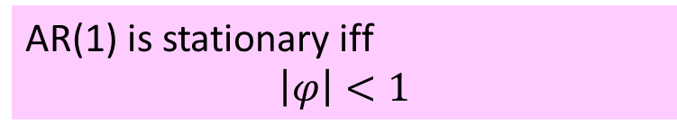







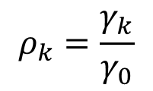



Autoregressive of Order 1
● $φ$ is a constant number
● $X_{0}=ε_{0}$
● $X_{1}=φX_{0}+ε_{1}=φε_{0}+ε_{1}$
● $X_{2}=φX_{1}+ε_{2}=φ^{2}ε_{0}+φε_{1}+ε_{2}$
$$⋮$$
● $X_{t}=φ^{t}ε_{0}+…+φε_{t−1}+ε_{t}$
The following time series is an AR(1). Compute the ACF and discuss stationarity.
$$X_{t}=φ X_{t−1}+ε_{t}$$
$$X_{0}=ε_{0}$$
$$ε_{t} \sim ^{i.i.d} N\left(0, σ\right)$$
AR(1) is stationary iff
$$\left|φ\right|<1$$
$$μ_{t}=0$$
$$γ_{0}=σ^{2}/(1−φ^{2})$$
$$γ_{k}=φγ_{k−1}$$
$$γ_{1}=φγ_{0}$$
$$={φ σ}^{2}/(1−φ^{2})$$
$$γ_{2}=φγ_{1}$$
$$={φ^{2}σ}^{2}/(1−φ^{2})$$
$$ρ_{k}$$
$$φ=−0.8$$
$$ρ_{k}$$
$$φ=0.8$$
$$⋮$$
1
1
$$γ_{k}={φ^{k}σ}^{2}/(1−φ^{2})$$
$$ρ_{k}=\frac{γ_{k}}{γ_{0}}$$
$$=φ^{k}$$
$$k=1,2,…$$
$$k$$
$$k$$
0
1
2
3
4
5
6
0
1
2
3
4
5
6
-1
-1
Notes:
So, we learned that …
A VERY important point, the AR(1) time series is stationary iff $\left|φ\right|<1$
In the ACF plot, for example if $φ=0.8$, we have a decreasing pattern, the larger $φ$ is, the slower the decrease is. If $φ$ is negative, we have an alternating decreasing pattern.
This ACF pattern is similar to what a non-stationary time series has, but the decrease toward zero is faster. Is there a way to recognize this stationary time series and identify that? Well, there is

Slide 7
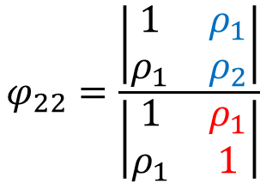


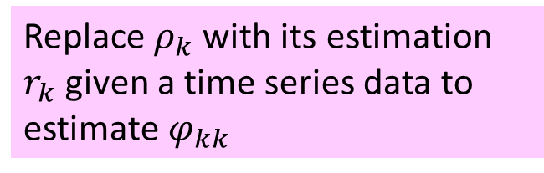
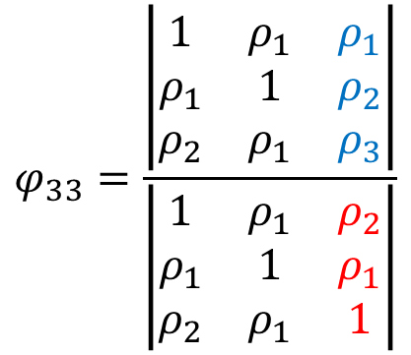
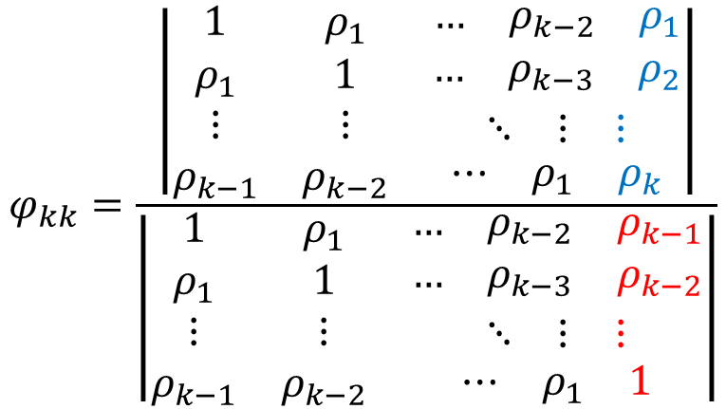
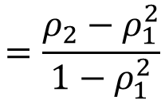
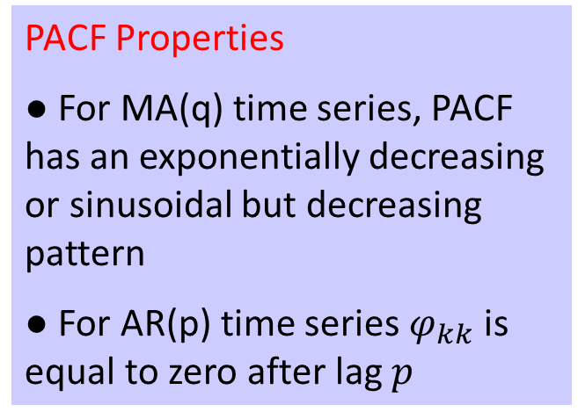


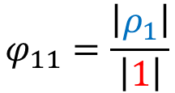
Partial Autocorrelation Function
PACF Properties
● For MA(q) time series, PACF has an exponentially decreasing or sinusoidal but decreasing pattern
● For AR(p) time series $φ_{kk}$ is equal to zero after lag $p$
PACF between $X_{t}$ and $X_{t−k}$ is shown by $φ_{kk}$, measures correlation between $X_{t}$ and $X_{t−k}$when the relationships of intervening variates $X_{t−1},…,X_{t−k+1}$is removed.
One easy way to compute $φ_{kk}$ is
$$φ_{kk}=\frac{\left|\begin{matrix}1 & ρ_{1} & \begin{matrix}… & ρ_{k−2} & ρ_{1}\end{matrix} \\ ρ_{1} & 1 & \begin{matrix}… & ρ_{k−3} & ρ_{2}\end{matrix} \\ \begin{matrix}⋮ \\ ρ_{k−1}\end{matrix} & \begin{matrix}⋮ \\ ρ_{k−2}\end{matrix} & \begin{matrix}\begin{matrix}⋱ & ⋮ & ⋮\end{matrix} \\ \begin{matrix}⋯ & ρ_{1} & ρ_{k}\end{matrix}\end{matrix}\end{matrix}\right|}{\left|\begin{matrix}1 & ρ_{1} & \begin{matrix}… & ρ_{k−2} & ρ_{k−1}\end{matrix} \\ ρ_{1} & 1 & \begin{matrix}… & ρ_{k−3} & ρ_{k−2}\end{matrix} \\ \begin{matrix}⋮ \\ ρ_{k−1}\end{matrix} & \begin{matrix}⋮ \\ ρ_{k−2}\end{matrix} & \begin{matrix}\begin{matrix}⋱ & ⋮ & ⋮\end{matrix} \\ \begin{matrix}⋯ & ρ_{1} & 1\end{matrix}\end{matrix}\end{matrix}\right|}$$
Replace $ρ_{k}$ with its estimation $r_{k}$ given a time series data to estimate $φ_{kk}$
$$φ_{11}=\frac{\left|ρ_{1}\right|}{\left|1\right|}$$
$$=ρ_{1}$$
$$φ_{33}=\frac{\left|\begin{matrix}1 & ρ_{1} & ρ_{1} \\ ρ_{1} & 1 & ρ_{2} \\ ρ_{2} & ρ_{1} & ρ_{3}\end{matrix}\right|}{\left|\begin{matrix}1 & ρ_{1} & ρ_{2} \\ ρ_{1} & 1 & ρ_{1} \\ ρ_{2} & ρ_{1} & 1\end{matrix}\right|}$$
$$φ_{22}=\frac{\left|\begin{matrix}1 & ρ_{1} \\ ρ_{1} & ρ_{2}\end{matrix}\right|}{\left|\begin{matrix}1 & ρ_{1} \\ ρ_{1} & 1\end{matrix}\right|}$$
$$=\frac{ρ_{2}−ρ_{1}^{2}}{1−ρ_{1}^{2}}$$
$$k=1,2,…$$
Notes:
That bring us to Partial Autocorrelation Function or PACF. Partial Autocorrelation between $X_{t}$ and $X_{t−k}$ is shown by $φ_{kk}$ and defined as the common autocorrelation between $X_{t}$ and $X_{t−k}$when the relationships of intervening variates $X_{t−1},…,X_{t−k+1}$is removed. Theoretically, it can be computed using this quotient where we have determinant of two matrices of autocorrelations in numerator and denominator. Both matrices are k by k, their first (k-1) columns is identical, the difference is in their last column.
Lets see how to compute it for the first few lags. Note that PACF at lag zero is not given, as it does not make any sense based on the way it is defined.
A VERY important point,

Slide 8





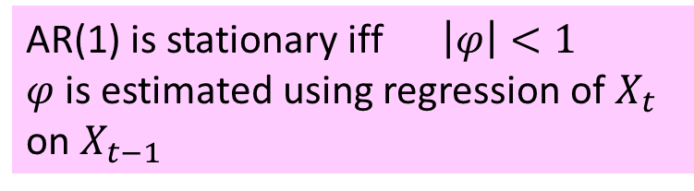


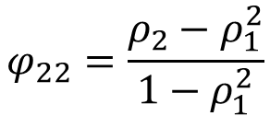



PACF for AR(1)
● $φ$ is a constant number
● $X_{0}=ε_{0}$
● $X_{1}=φX_{0}+ε_{1}=φε_{0}+ε_{1}$
● $X_{2}=φX_{1}+ε_{2}=φ^{2}ε_{0}+φε_{1}+ε_{2}$
$$⋮$$
● $X_{t}=φ^{t}ε_{0}+…+φε_{t−1}+ε_{t}$
Given the following AR(1) time series. Compute the PACF and plot it.
$$X_{t}=φ X_{t−1}+ε_{t}$$
$$X_{0}=ε_{0}$$
$$ε_{t} \sim ^{i.i.d} N\left(0, σ\right)$$
AR(1) is stationary iff $\left|φ\right|<1$
$φ$ is estimated using regression of $X_{t}$ on $X_{t−1}$
$$μ_{t}=0$$
$$γ_{0}=σ^{2}/(1−φ^{2})$$
$$γ_{k}=φγ_{k−1}$$
$$ρ_{k}=φ^{k}$$
$$k=1,2,…$$
$$φ_{11}=ρ_{1}$$
$$=φ$$
$$φ_{kk}$$
$$φ=−0.8$$
$$φ_{kk}$$
$$φ=0.8$$
1
1
$$φ_{22}=\frac{ρ_{2}−ρ_{1}^{2}}{1−ρ_{1}^{2}}$$
$$=0$$
$$φ_{kk}=0$$
$$k=2,3,…$$
1
2
5
6
$$k$$
$$k$$
3
4
1
2
3
4
5
6
-1
-1
Notes:
Lets compute the PACF for our AR(1) and plot that for these two values of $φ$. Earlier, we figured out that for this time series …
PACF for lags greater than equal to 2 is zero since AR(1), see computations for lag 3 in the transcripts section,
$$φ_{33}=\frac{\left|\begin{matrix}1 & ρ_{1} & ρ_{1} \\ ρ_{1} & 1 & ρ_{2} \\ ρ_{2} & ρ_{1} & ρ_{3}\end{matrix}\right|}{\left|\begin{matrix}1 & ρ_{1} & ρ_{2} \\ ρ_{1} & 1 & ρ_{1} \\ ρ_{2} & ρ_{1} & 1\end{matrix}\right|}=\frac{\left|\begin{matrix}1 & φ & φ \\ φ & 1 & φ^{2} \\ φ^{2} & φ & φ^{3}\end{matrix}\right|}{\left|\begin{matrix}1 & φ & φ^{2} \\ φ & 1 & φ \\ φ^{2} & φ & 1\end{matrix}\right|}=\frac{φ\left|\begin{matrix}1 & φ & φ \\ φ & 1 & φ^{2} \\ φ & 1 & φ^{2}\end{matrix}\right|}{\left|\begin{matrix}1 & φ & φ^{2} \\ φ & 1 & φ \\ φ^{2} & φ & 1\end{matrix}\right|}=0$$
Since row 2 and 3 in the numerator are not independent

Slide 9
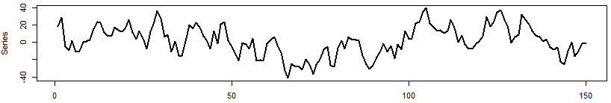
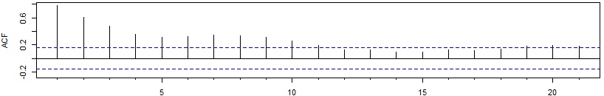
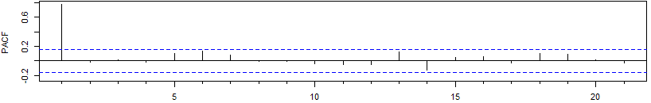



Example
Examples of AR(1) time series with their ACF & PACF plot.
$$X_{t}=0.8 X_{t−1}+ε_{t}$$
$$X_{0}=ε_{0}$$
$$ε_{t} \sim ^{i.i.d} N\left(0, 10\right)$$
Notes:
Here we see a simulated AR(1) time series with parameter $φ$ as 0.8. This is a stationary time series. Looking at the time plot, you can’t really tell the difference between AR(1) and a white noise. Looking at the ACF plot, we have a decreasing pattern and PACF shows that only the first spike, that is ${\hat{φ}}_{11}$ is non-zero. Of course, you won’t see the exact value of zero when you work with time series data, but 95% of the spikes fall within the white noise boundary.

Slide 10
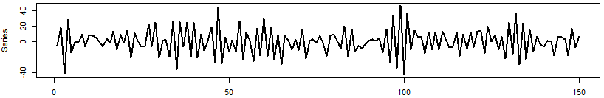
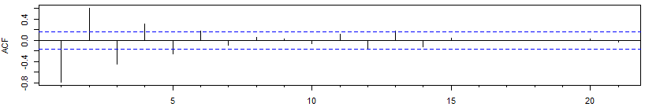
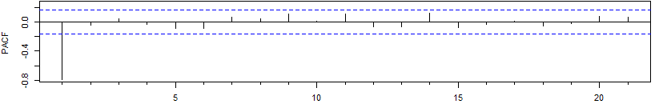

Example
Examples of AR(1) time series with their ACF & PACF plot.
$$X_{t}=−0.8 X_{t−1}+ε_{t}$$
$$X_{0}=ε_{0}$$
$$ε_{t} \sim ^{i.i.d} N\left(0, 10\right)$$
Notes:
Another simulated AR(1) time series, this time with parameter $φ$ as -0.8. The ACF plot, shows a sinusoidal but decreasing pattern. See how the ACF alternates when φ is negative. The PACF shows a significant value for ${\hat{φ}}_{11}$. This confirms what is expected to see for a AR(1) ACF and PACF.

Slide 11




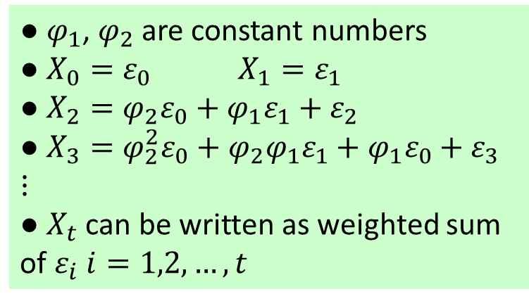


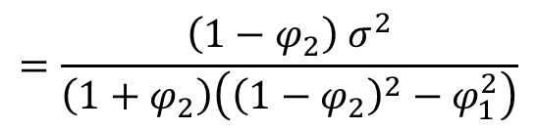






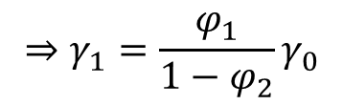
Autoregressive of Order 2
● $φ_{1}$, $φ_{2}$are constant numbers
● $X_{0}=ε_{0}$ $X_{1}=ε_{1}$
● $X_{2}=φ_{2}ε_{0}+φ_{1}ε_{1}+ε_{2}$
● $X_{3}=φ_{2}^{2}ε_{0}+φ_{2}φ_{1}ε_{1}+φ_{1}ε_{0}+ε_{3}$
$$⋮$$
● $X_{t}$ can be written as weighted sum of $ε_{i}$ $i=1,2,…,t$
The following time series is an AR(2). Compute the ACF & PACF.
$$X_{t}=φ_{1}X_{t−1}+φ_{2}X_{t−2}+ε_{t}$$
$$ε_{t} \sim ^{i.i.d} N\left(0, σ\right)$$
$$μ_{t}=E\left(X_{t}\right)$$
$$=E\left(φ_{1}X_{t−1}+φ_{2}X_{t−2}+ε_{t}\right)$$
$$=φ_{1}E\left(X_{t−1}\right)+φ_{2}E\left(X_{t−2}\right)+E\left(ε_{t}\right)=0$$
$$γ_{k}=Cov\left(X_{t},X_{t−k}\right)$$
$$=E\left(X_{t}X_{t−k}\right)−E\left(X_{t}\right)E\left(X_{t−k}\right)$$
$$=E\left(\left(φ_{1}X_{t−1}+φ_{2}X_{t−2}+ε_{t}\right) X_{t−k}\right)$$
$$=E\left(φ_{1}X_{t−1}X_{t−k}+{φ_{2}X}_{t−2}X_{t−k}+X_{t−k}ε_{t}\right)$$
$$=φ_{1}E\left(X_{t−1}X_{t−k}\right)+φ_{2}E\left(X_{t−2}X_{t−k}\right)+E\left(X_{t−k}ε_{t}\right)$$
$$=φ_{1} γ_{k−1}+φ_{2} γ_{k−2}$$
$$k=1,2,…$$
$$γ_{1}=φ_{1} γ_{1−1}+φ_{2} γ_{1−2}$$
$$=φ_{1} γ_{0}+φ_{2} γ_{1}$$
$$⇒γ_{1}=\frac{φ_{1}}{1−φ_{2}}γ_{0}$$
$$=\frac{\left(1−φ_{2}\right) σ^{2}}{\left(1+φ_{2}\right)\left({\left(1−φ_{2}\right)}^{2}−φ_{1}^{2}\right)}$$
$$γ_{k}=γ_{−k}$$
$$γ_{0}=Var\left(X_{t} \right)$$
$ε_{t}$ is independent from $X_{t−1}$, $X_{t−2}$, …
Notes:
Lets investigate properties of an AR(2). An autoregressive of order 2 is defined using this expression. Each value depends on two former values in time plus a new white noise, and we have two parameters, shown by $φ_{1}$ and $φ_{2}$
Staring with the mean function,
$$γ_{0}=Var\left(φ_{2}X_{t−2}+φ_{1}X_{t−1}+ε_{t}\right)=φ_{2}^{2}Var\left(X_{t−2}\right)+φ_{1}^{2}Var\left(X_{t−1}\right)+Var\left(ε_{t}\right)+2φ_{2}φ_{1}Cov\left(X_{t−2},X_{t−1}\right)+2φ_{2}Cov\left(X_{t−2},ε_{t}\right)+2φ_{1}Cov\left(X_{t−1},ε_{t}\right)$$
$$=φ_{2}^{2}γ_{0}+φ_{1}^{2}γ_{0}+σ^{2}+2φ_{2}φ_{1}γ_{1}+0+0=\left(φ_{2}^{2}+φ_{1}^{2}\right)γ_{0}+2φ_{2}φ_{1}γ_{1}+σ^{2}$$
But $γ_{1}=φ_{2} γ_{1}+φ_{1} γ_{0}$, so, we can plug this in the first formula and simplify to get
$$γ_{0}=\frac{\left(1−φ_{2}\right) σ^{2}}{\left(1+φ_{2}\right)\left({\left(1−φ_{2}\right)}^{2}−φ_{1}^{2}\right)}$$

Slide 12






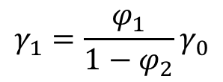


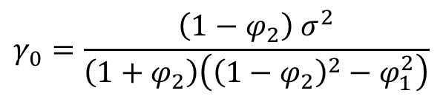



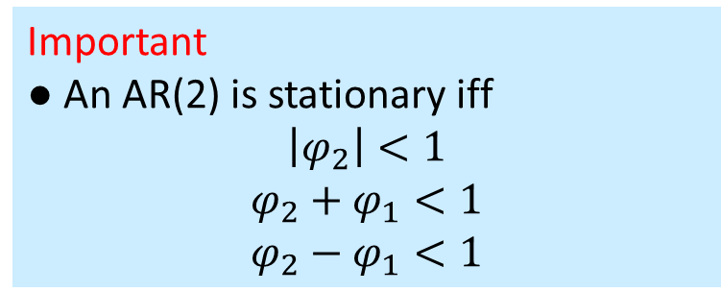



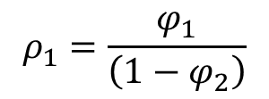
Autoregressive of Order 2
Important
● An AR(2) is stationary iff
$$\left|φ_{2}\right|<1$$
$$φ_{2}+φ_{1}<1$$
$$φ_{2}−φ_{1}<1$$
The following time series is an AR(2). Compute the ACF & PACF.
$$X_{t}=φ_{1}X_{t−1}+φ_{2}X_{t−2}+ε_{t}$$
$$ε_{t} \sim ^{i.i.d} N\left(0, σ\right)$$
$$γ_{0}=\frac{\left(1−φ_{2}\right) σ^{2}}{\left(1+φ_{2}\right)\left({\left(1−φ_{2}\right)}^{2}−φ_{1}^{2}\right)}$$
$$γ_{1}=\frac{φ_{1}}{1−φ_{2}}γ_{0}$$
$$μ_{t}=0$$
$$γ_{k}=φ_{1} γ_{k−1}+φ_{2} γ_{k−2}$$
$$ρ_{0}=1$$
$$ρ_{1}=\frac{φ_{1}}{\left(1−φ_{2}\right)}$$
$$ρ_{k}$$
$$φ_{1}=0.5,φ_{2}=0.3$$
$$φ_{kk}$$
$$φ_{1}=0.5,φ_{2}=0.3$$
$$ρ_{k}=φ_{1} ρ_{k−1}+φ_{2} ρ_{k−2}$$
1
1
$$φ_{11}=ρ_{1}$$
$$φ_{22}=\frac{ρ_{2}−ρ_{1}^{2}}{1−ρ_{1}^{2}}$$
1
2
3
4
5
6
$$k$$
1
2
3
4
5
6
$$k$$
$φ_{kk}=0$ $k≥3$
-1
-1
Notes:
So, we learned that …
$φ_{kk}$ is zero for lag 3 and more since autocorrelation for lag 3 and more is a linear combination of past autocorrelations.
For these two values of $φ_{1}$ and $φ_{2}$, the ACF and PACF plot looks like these. We have a decreasing pattern for ACF, and only two non-zero values for PACF at lag 1 and 2

Slide 13
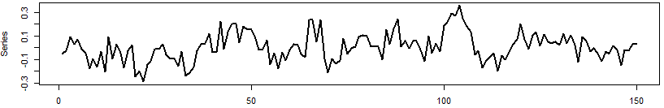
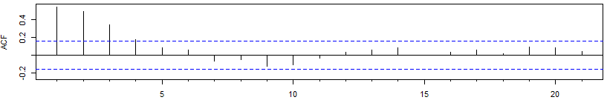
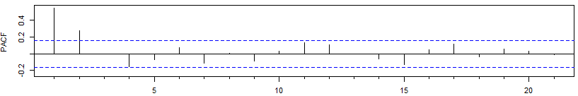
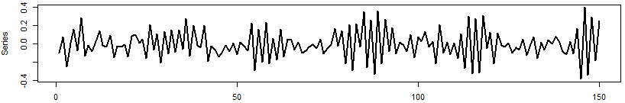
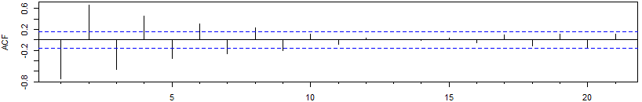
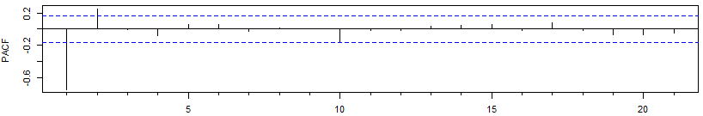
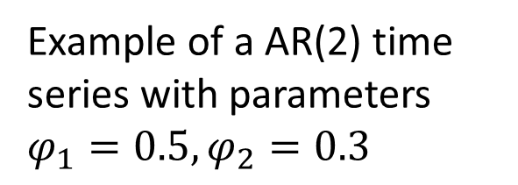
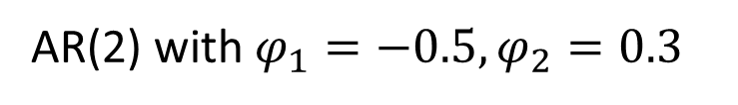
Example
Example of a AR(2) time series with parameters $φ_{1}=0.5,φ_{2}=0.3$
AR(2) with $φ_{1}=−0.5,φ_{2}=0.3$
Notes:
And the second time series is another AR(2) with these parameters, this has been simulated using the same white noise as the first example

Slide 14


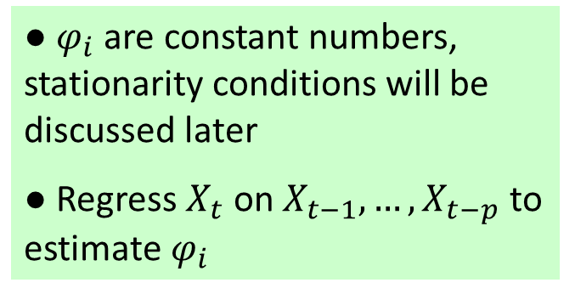
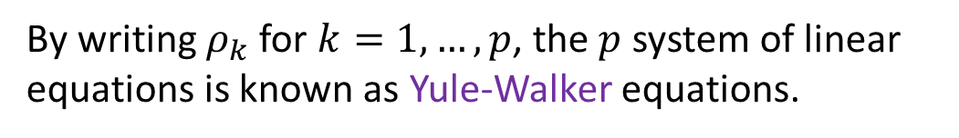




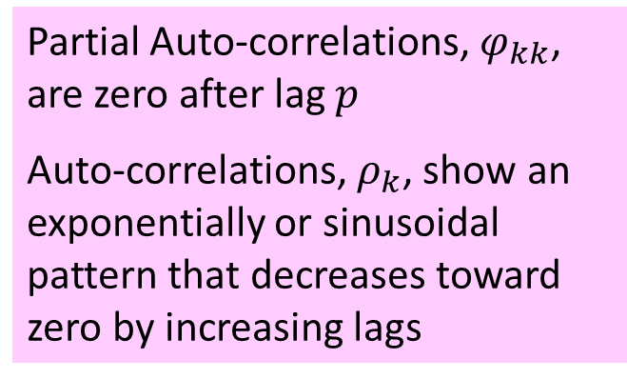

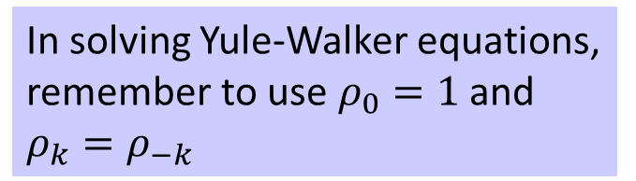




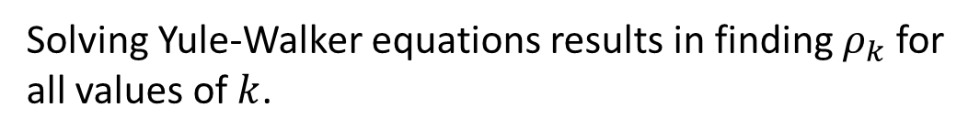
Autoregressive of Order p
● $φ_{i}$are constant numbers, stationarity conditions will be discussed later
● Regress $X_{t}$ on $X_{t−1},…,X_{t−p}$ to estimate $φ_{i}$
The following time series is an AR(p)
$$X_{t}=φ_{1}X_{t−1}+…+φ_{p}X_{t−p}+ε_{t}$$
$$ε_{t} \sim ^{i.i.d} N\left(0, σ\right)$$
$$μ_{t}=$$
$$0$$
Partial Auto-correlations, $φ_{kk}$, are zero after lag $p$
Auto-correlations, $ρ_{k}$, show an exponentially or sinusoidal pattern that decreases toward zero by increasing lags
$$γ_{0}=$$
$${φ_{1}γ_{1}+φ_{2}γ_{2}+…+φ_{p}γ_{p}+σ}^{2}$$
$$γ_{k}=$$
$$φ_{1}γ_{k−1}+φ_{2}γ_{k−2}+…+φ_{p}γ_{k−p}$$
$$k=1,2,…$$
$$ρ_{k}=φ_{1}ρ_{k−1}+φ_{2}ρ_{k−2}+…+φ_{p}ρ_{k−p}$$
$$k=1,2,…$$
By writing $ρ_{k}$ for $k=1,…,p$, the $p$ system of linear equations is known as Yule-Walker equations.
In solving Yule-Walker equations, remember to use $ρ_{0}=1$ and $ρ_{k}=ρ_{−k}$
Solving Yule-Walker equations results in finding $ρ_{k}$ for all values of $k$.
Notes:
Lets generalize what we learned today about autoregressive 1 and 2 time series to AR(p).

Slide 15
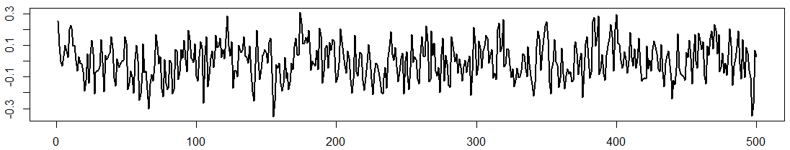




Example
Identify the type of the given time series using their ACF & PACF where
$$ε_{t} \sim ^{i.i.d} N\left(0, 0.1\right)$$
$$X_{t}=0.5X_{t−1}−0.3X_{t−2}+0.2X_{t−3}+ε_{t}$$
$$X_{t}=ε_{t}−0.75ε_{t−1}+0.5ε_{t−2}−0.25ε_{t−3}$$
Notes:
Looking at the time plot, this is a stationary time series. Looking at the ACF plot, we have decreasing a pattern, there are three-four bars that fall outside the white noise boundary, one happens at lag 11. In the PACF, the first three bars are outside the white noise boundary, all the rest fall inside. Those first three that are outside, are significantly greater than other bars. All in all, there is a good indication of a AR(3) time series.
The second time plot shows a stationary time series. Looking at the ACF plot, the first three bars fall outside the boundary, the rest of the bars are inside except for one at lag 23. In the PACF, we have bars outside the boundary up to lag 6. So, what do you think? AR or MA? If you guessed moving average, your guess is right, we used this equation to simulate this time series, this is a moving average of order 3.
See the differences in the formulas between MA and AR

Slide 16






Example
Identify the type of the given time series using their ACF & PACF.
$$X_{t}=−0.15X_{t−1}−0.75X_{t−2}+ε_{t}$$
$$X_{t}=−0.52X_{t−1}+0.5X_{t−2}+ε_{t}$$
Notes:
Here, the time plot shows a stationary time series. The ACF shows a decreasing semi-alternating pattern. The PACF has two bars outside the white noise boundary. We used this equation to simulate this time series, that is an autoregressive of order 2.
Lets start with the ACF & PACF plots this time, what do you think here? We have slowly decreasing alternating pattern in ACF and one huge bar at lag 1 in PACF. This time series is actually non-stationary and you can see that from the time plot. Although, the equation that is used to simulate this looks like an AR(2), the parameters in the formula does not satisfy the stationarity conditions.
You can make reliable decisions by practicing, follow these topics with the accompanied R sessions and provided practice problems to sharpen your skills.

Slide 17


Practice Problems
1. Load “sims.csv” data into your session and answer the following questions for simulated time series $x_{15t}$.
a. Graph a time plot, ACF, and PACF plot. Estimate the type and order of this time series using these plots.
b. Write down values of $r_{k}$ for k=1,…,5. Then compute ${\hat{φ}}_{kk}$ for k=1,2,3 using the $r_{k}$ values by a calculator or excel. Compare them with the computed values in R.
c. Plot scatterplot of $x_{15t}$ versus $x_{15t−1}$ and compute their correlation. Conform that it is equal to ${\hat{φ}}_{11}$.
d. Write down Yule-Walker equations and estimate the parameters using method of moments.
2. Repeat the same steps for $x_{16t}$in “sims.csv” dataset.
Notes:
To save values of r_k and see them:
temp = acf(sims$x15_t)
temp$acf
To lag 1 a vector of data next to its original values
data = data.frame(sims$x15_t)
data$l1 = NA
data$l1[2:nrow(data)] = sims$x15_t[1:nrow(data)-1]

Slide 18


Practice Problems
3. Consider the AR(2) process given by
$$X_{t}=−\frac{1}{2} X_{t−2}+X_{t−1}+ε_{t}$$
Is this process stationary? If so, what is its ACF & PACF?
4. Show that the ACF of the stationary second-order AR process
$$X_{t}=\frac{1}{12} X_{t−2}+\frac{1}{12}X_{t−1}+ε_{t}$$
is given by
$$ρ_{k}=\frac{45}{77}{\left(\frac{1}{3}\right)}^{\left|k\right|}+\frac{32}{77}{\left(−\frac{1}{4}\right)}^{\left|k\right|}$$

